Slide 1
Working with Shapes and Graphics
Word 2016

Slide 2
Word allows you to do much more than simply insert or place graphics. For our second lesson in this series, we will focus on the graphic design functions in Word such as pictures, SmartArt, screenshots, and other items that can be found on the “Insert” tab.

Slide 3
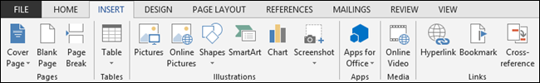
Images and Multimedia
You don’t have to think of Word as simply a word processing program. It has requisite tools for doing some pretty nifty page layout. While it’s not a feature-complete or robust as a professional page layout program such as Adobe InDesign. You can still get very professional looking results if you know what’s in your toolbox and how to use it.

Slide 4
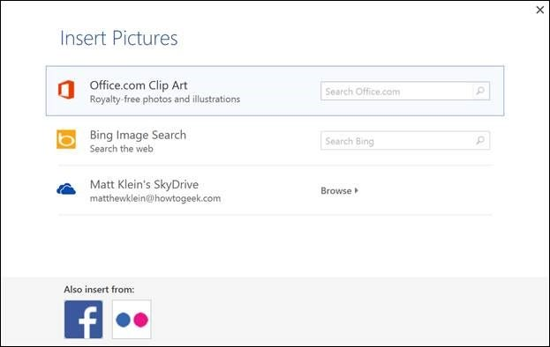
Pictures and Online Pictures
Both “Pictures” and “Online Pictures” accomplish the same goal. The only difference is that “Pictures” means you can insert pictures locally, while “Online Pictures” allows you to insert images from an internet-based source such as clip art from Office.com, Bing, or OneDrive (formerly SkyDrive).
You can also insert pictures from your Facebook profile or Flickr although you could always just save the pictures you want to insert to your computer and then insert them from there if you don’t want to connect Office to these profiles.

Slide 5
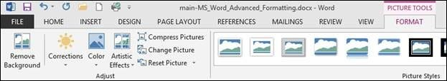
Picture Tools
As always, when you want to edit a picture or any element place in a Word document, you can click on it and the appropriate tab will appear on the Ribbon.
With pictures, that tab is “Picture Tools.” Here we see you can make all kinds of corrections to the picture on-the-fly. For example, you can correct brightness and contrast, the color, add a border.
Where you position and how you wrap text will also play a large role in formatting your documents.

Slide 6
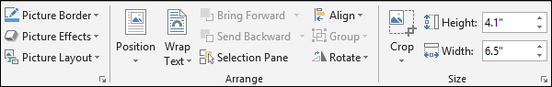
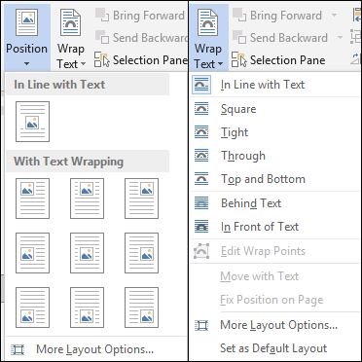
Picture Tools
Where you position and how you wrap text will also play a large role in formatting your documents.
Here we see those controls. In our documents, we don’t worry so much about word wrapping or positioning because Word isn’t the final step toward publishing online. However, if you’re going to produce something WYSIWYG (What You See is What You Get), such as for a PDF or print publication, then these things will definitely matter.

Slide 7
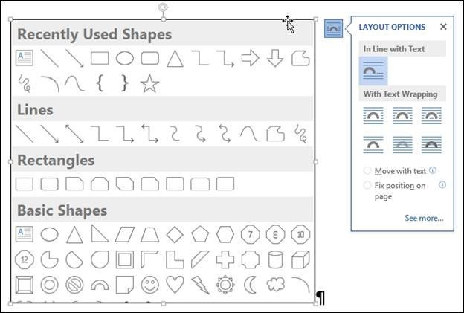
Picture Tools
Also, there are a couple ways you make changes to your pictures online, such as resizing, rotating, and moving them. In the following image, you see these controls, many of which you will likely be familiar with.
Finally, if you click on the little “Layout Options” button, you can change your text wrapping without going to the Ribbon.
Clicking on “See more…” at the bottom of the “Layout Options” opens the full-blown “Layout” dialog.

Slide 8
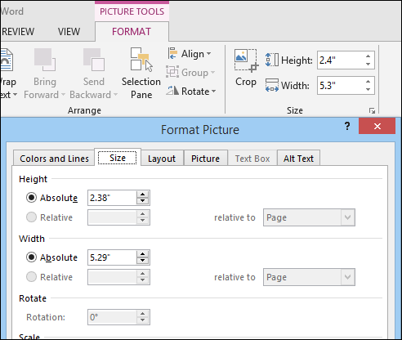
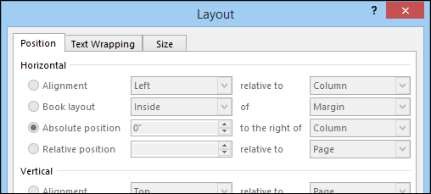
Picture Tools
Note, the size tab both on the Ribbon the “Layout” dialog allows you to specifically resize, rotate, and scale your pictures, rather than relying wholly on winging it:
We’d like to spend the whole day talking about formatting images in Word, but as you can see, there’s a ton of options at your disposal. Let’s move on now to other objects you can insert into your documents, starting with “Shapes.”

Slide 9
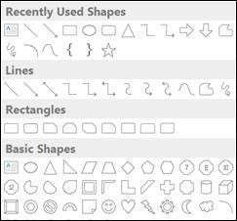
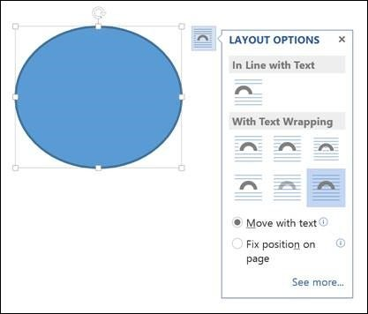
SHAPES
Microsoft Word 2013 comes with an array of built-in shapes, which you can use to create callouts, boxes, stars, and other shapes.
When you choose a shape, you simply draw it on a blank space on the page. It doesn’t matter if you get it perfect or just the way you want it because you can adjust it to your heart’s content once it is placed in your document.
Note in the screenshot, the previously mentioned little “handles” you can use to resize and rotate your shapes.
At the bottom of the “Shapes” menu, there’s an option to create a “new drawing canvas.” This will open, what is essentially a text box for shapes.

Slide 10
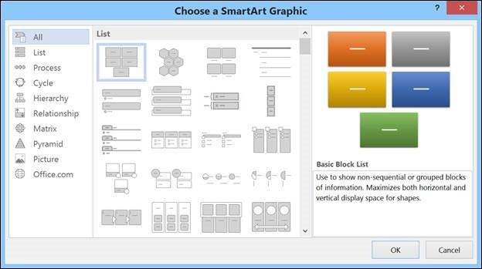
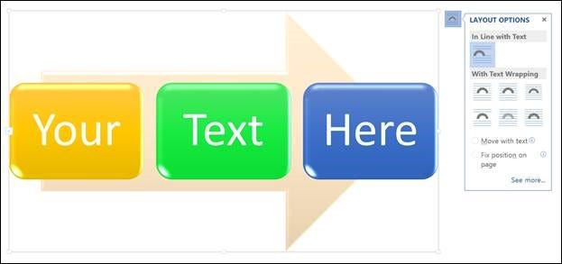
SmartArt and WordArt
Think of SmartArt as premade drawing canvases that you can insert into your document and then customize as you like. Simply pick an arrangement, such as a list, process, or cycle.
As you can see, we created a graphic based on a “Continuous Block Process.” When we click on the text boxes, we can edit what is inside. There are also the usual grab handles needed to resize the image, and the “Layout Options” allowing you to wrap text to your preference

Slide 11
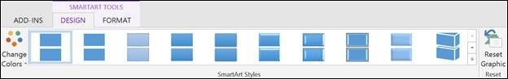
SmartArt and WordArt
If you use SmartArt, note that the Ribbon changes to reflect this. The “SmartArt Tools” features two tabs: “Design” and “Format.” Let’s cover each one and its features.
The right half of the “Format” tab allows you to pick from a number of “SmartArt Styles” and you can also “Change Colors.”

Slide 12
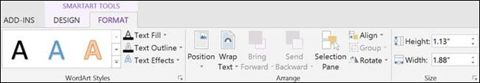
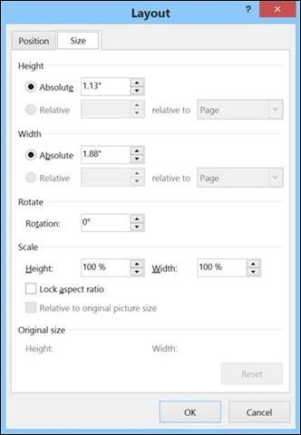
SmartArt and WordArt
The right side of the “Format” tab is used for affecting changes to text. These include “WordArt Styles” and other effects such as fill and outline. Beyond that, you can arrange multiple layers by sending them forward and backward.
The “Layout” dialog pops out if you select the little arrow in the bottom-right corner of the “size” section or you can choose more options from any of the drop-down menus including “Position”, “Align”, and “Rotate.”

Slide 13
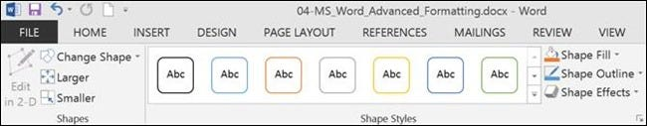
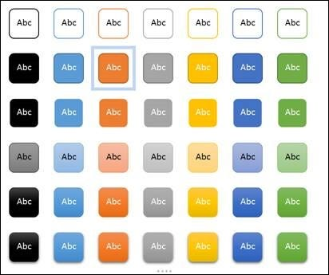
SmartArt and WordArt
On the left side of the “Format” tab you can select any of your shapes and change them to another, and also make them larger or smaller.
If you click on “Shape Styles” you will be able to choose from a selection of pre-defined shapes and colors.
Shift right just slightly and you will find controls to alter the fill. Choose from various “Theme Colors” or select your own. You an also use pictures, gradients, and textures for even more fill options.

Slide 14
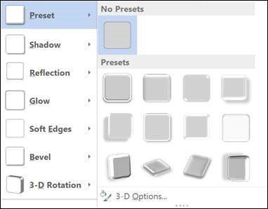
SmartArt and WordArt
Finally, “Shape Effects” has quite a few options for enhancing your shapes, many of which will give them a cool 3D effect that you can adjust by clicking 3D Options at the bottom of the of the menu.

Slide 15
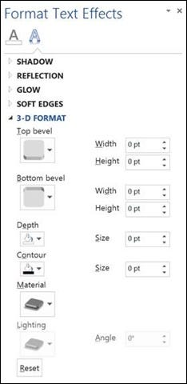
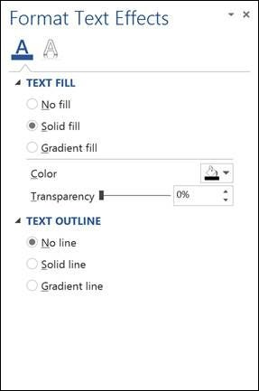
Format Text Effects
Let’s take a closer look at this because it contains a pretty sizable amount of features. We’ll cover the basics so that you’re more aware of them. The pane titled, “Format Text Effects,” slides out from the right edge.
Regardless, this dialog box will allow you to quickly work with text, so you don’t have to repeatedly keep going to the ribbon to change things. Note also that the dialog is split into functions, “Text Fill and Outline” and “Text Effects.” “Text Fill and Outline” is simple enough to figure out, and is used to enhance how text appears.

Slide 16
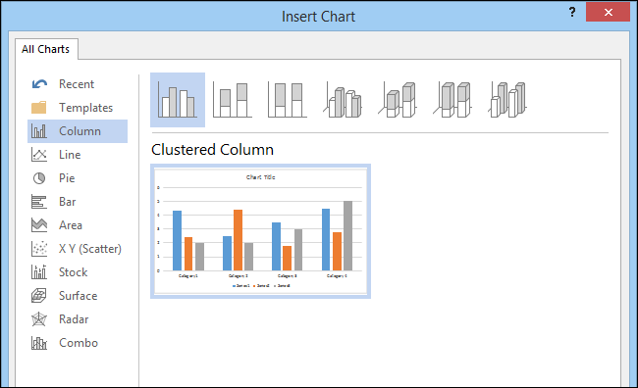
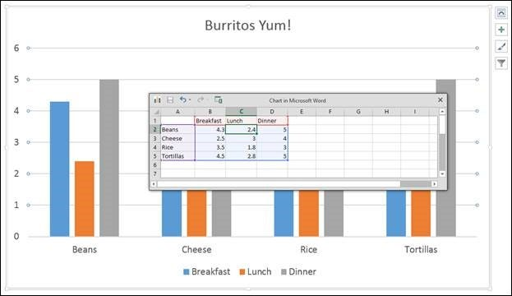
CHART
Charts are a great way to visually display data sets and Word 2013 comes jam packed with a large assortment of Charts to choose from, including columns, pie, bar charts and much, much more.
When you choose a style, you’ll get a spreadsheet, which will allow you to enter the data points on your x and y axes. As you enter data, the chart will change.
Manipulating and formatting charts is easy. Whenever you click on a chart in your document, you’ll get the “Chart Tools,” which, as you might have guessed, is the Ribbon tab devoted solely to charts.

Slide 17
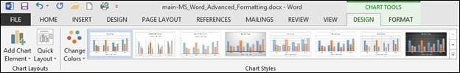
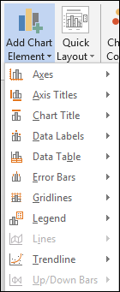
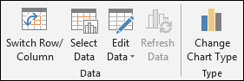
CHART
Using the “Design” tab, if you don’t like the colors or style of your chart, you can instantly apply changes to it without having to generate a new one.
If you decide you don’t think the layout works for this particular type of data, change it using “Quick Layout” or add another element such as another axis, chart title, gridlines, and more.
On the right side of the “Design” tab you will find essential tools for altering your data and you can also go back and completely change the type of chart you’re using.

Slide 18
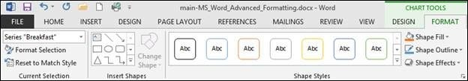
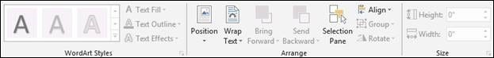
CHART
The “Chart Tools” also give you a “Format” tab so you can dress things up a bit by adding shapes and then being able to change the style, fill, and outline.
Turning to the right side of the “Format” tab, you are given options for adding and changing WordArt, arranging elements, and adjusting the size of your chart (which you can also do with the grab handles).
It’s easy also to affect changes inline too. When you click on a chart in your document, formatting controls appear along the upper-right corner. From top-to-bottom, you get “Layout options” so you can set your text wrapping. You can change chart elements with the plus (+) symbol, so if you want to change chart titles, add gridlines, and stuff like that.

Slide 19
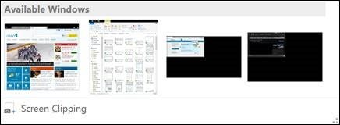
Screenshot & Online Video
The “Screenshot” feature will allow you to take a screen clip, which is automatically pasted in you document.
When you use the screenshot function, it will let you choose between any currently open windows, or you can select “Screen Clipping,” which will minimize Word allowing you to take a selection or full shot of your desktop.

Slide 20
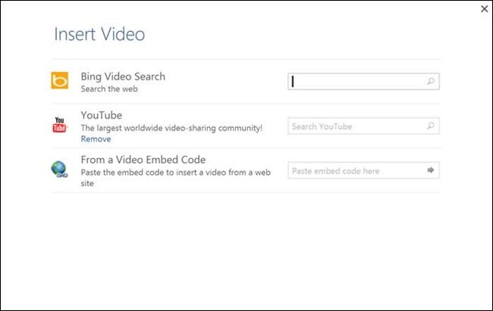
Screenshot & Online Video
You can insert “Online Video” such as Bing, YouTube, or video embed code into your document
When you embed a video, it will appear as if it is a regular picture, complete with grab handles and text wrap controls
Further, you can adjust how the embedded video thumbnail appears (as a picture) using the “Picture Tools” so you can make adjustments to the color, add a border, correct the contrast and brightness, and more

Slide 21
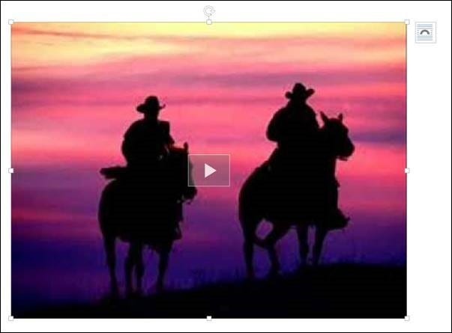
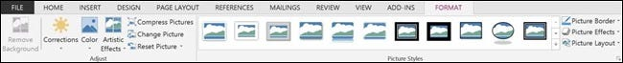
Screenshot & Online Video

Slide 22
OTHER TEXT FEATURES
Text Box
Text boxes are like their own little islands in Word. What we mean is, when you add a “Text Box” to your documents, it is immune to changes you make to the rest of the document. It is like a document within a document
Drop Cap
Drop caps are simply that one letter at the beginning of a chapter or book that is larger than the rest.
Using More than One Language
If you want to produce content in a language other than the one that comes with Word by default, you will likely need to purchase it. Open the Word “Options” and click on “Language

Slide 23
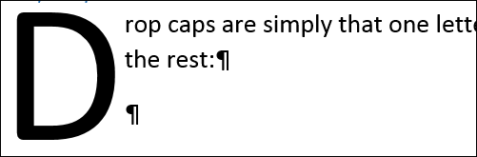
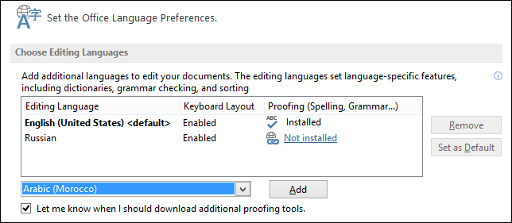
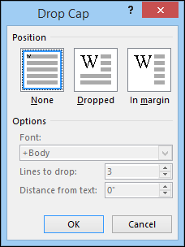
OTHER TEXT FEATURES

Slide 24
THANK YOU!
JONATHAN WALLAS
Phone
075-620-1455
Email
jonathanwallas4@gmail.com

